Slide 1
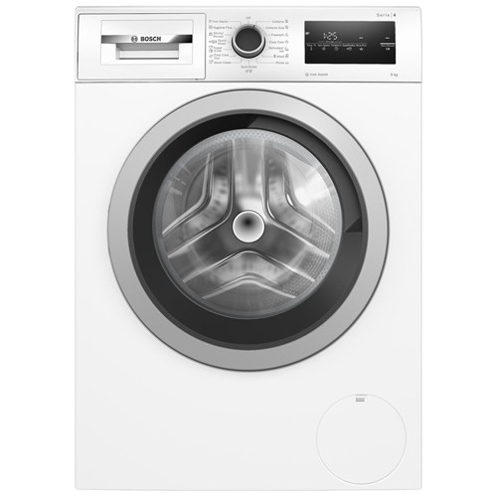
ELEC 3204
Major Project
Arnav Dhir | Devagya Budhiraja | Shun Ying Wong
Washing Machine

Slide 2
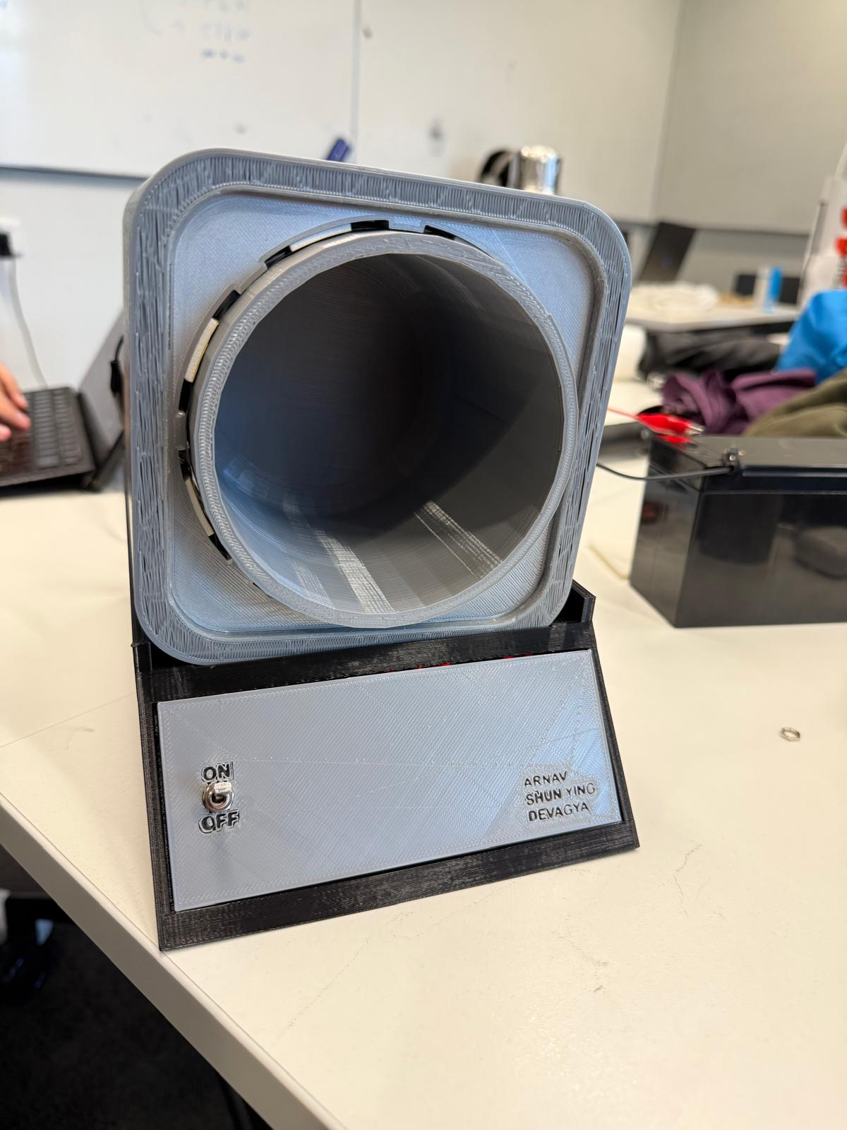
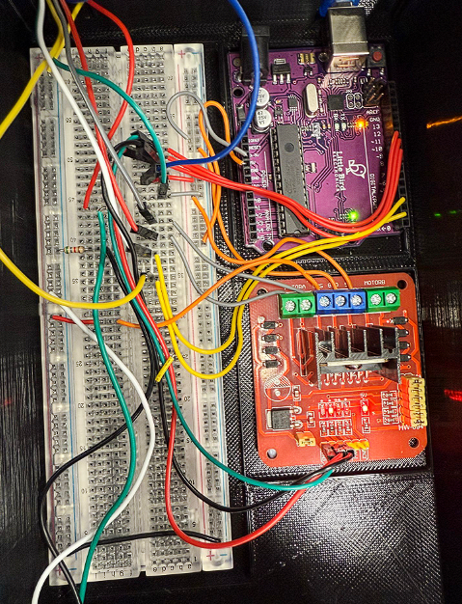

Our Set up
Washing Machine

Slide 3
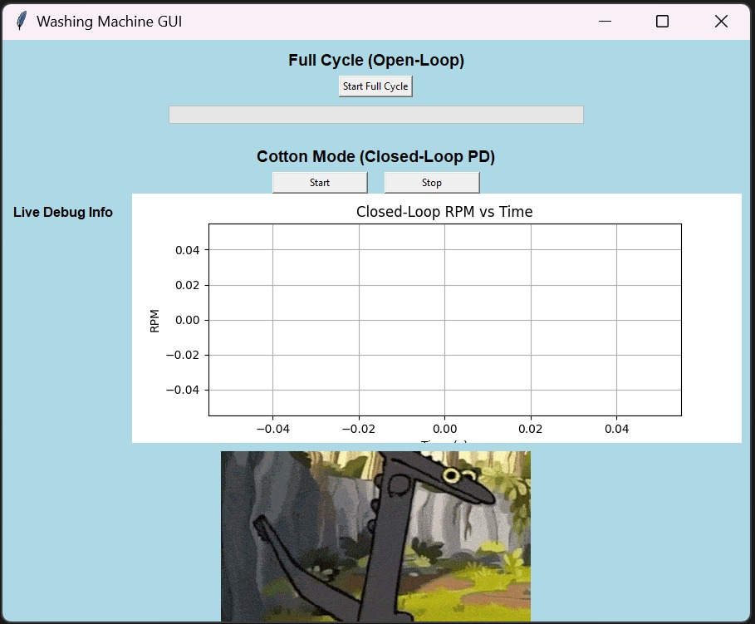
Washing Machine
Open Loop
Closed Loop
Mimics real washing modes:
Wash, clean, and spin
Motor spins in both directions at various speeds
Time-based control with no feedback needed
Motor runs in one direction at target speed
Add weight → RPM drops → system compensates
Feedback control adjusts input to maintain RPM
🧑‍💻 GUI for User input
🛑 Emergency stop for safety

Slide 4
Open Loop
Closed Loop
Mimics real washing modes:
Wash, clean, and spin dry
Motor spins in both directions at various speeds
Time-based control with no feedback needed
Motor runs in one direction at target speed
Add weight → RPM drops → system compensates
Feedback control adjusts input to maintain RPM
Washing Machine
GUI for User input
🛑 Emergency stop for safety

Slide 5
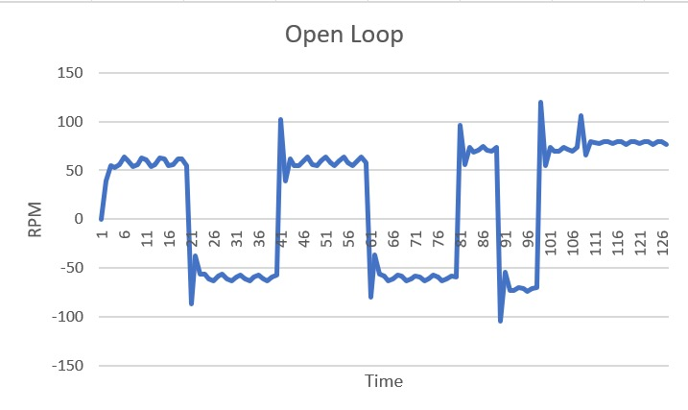
Open Loop
Closed Loop
Normal Soil: Wash – Clean – Spin dry
Motor runs in one direction at target speed
Add weight → RPM drops → system compensates
Feedback control adjusts input to maintain RPM
Clean
Mimics real washing modes:
Wash, rinse, and spin
Motor spins in both directions at various speeds
Time-based control with no feedback needed
3-step motor operation with timed fixed-speed control
Wash: 20 RPM for 21.5s
Clean: 40 RPM for 8.5s
Spin dry: 80 RPM for 5s
Total duration: 35s
Wash
Spin
Washing Machine
🧑‍💻 GUI for User input
🛑 Emergency stop for safety

Slide 6
Washing Machine
Open Loop
Closed Loop
Mimics real washing modes:
Wash, clean, and spin
Motor spins in both directions at various speeds
Time-based control with no feedback needed
Motor runs in one direction at target speed
Add weight → RPM drops → system compensates
Feedback control adjusts input to maintain RPM
🧑‍💻 GUI for User input
🛑 Emergency stop for safety

Slide 7
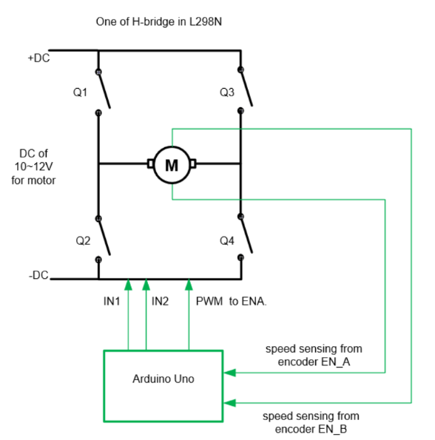
Closed Loop
Arduino controls motor via PWM signal to the H-bridge
Motor speed is measured using encoder feedback through EN_A & EN_B
Real-time speed is compared with target RPM inside Arduino
If motor slows down due to added weight, ➜ Arduino increases PWM duty cycle to restore RPM
This loop continues where its constantly correcting error → That’s negative feedback

Slide 8
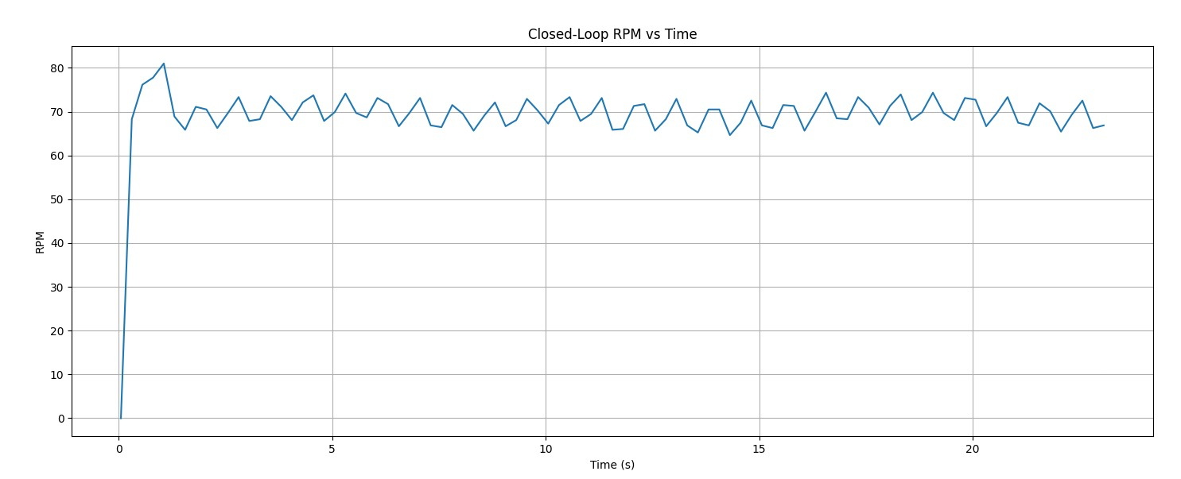
Washing Machine
Open Loop
Closed Loop
Mimics real washing modes:
Wash, rinse, and spin
Motor spins in both directions at various speeds
Time-based control with no feedback needed
Load-Sensitive Control
Motor runs in one direction at target speed
Add weight → RPM drops → system compensates
Feedback control adjusts input to maintain RPM
Weight added
RPM adjusts based on weight
→ Light load = higher RPM → Heavy load = reduced RPM
GUI for User input
🛑 Emergency stop for safety
ADD IMAGE
OF GUI

Slide 9
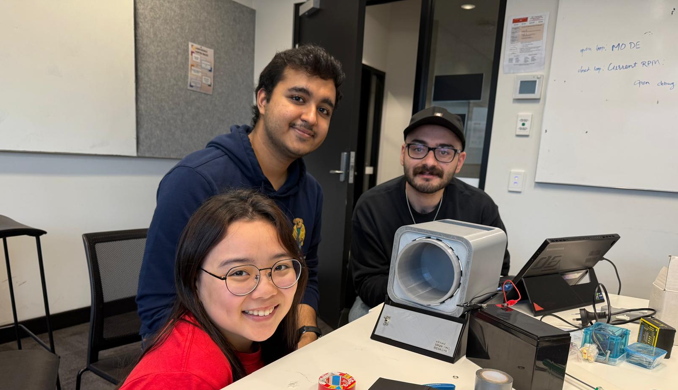
Thank You
“BabyGirl”
“Justified GirliePop”
“Oompaa Loompaa”

